Slide 1
A JSON HTTP Notation for extending application servers with third-party services A case study enabling a virtual file system for the University Cloud Suite
Alessio Giordano
Relatore: prof. Simone Palazzo
Mercoledì, 13 Dicembre 2023

Slide 2
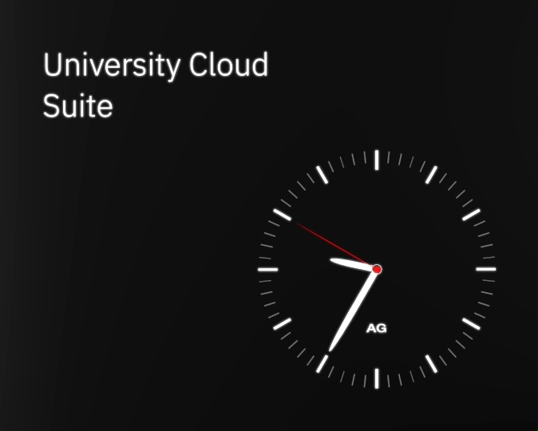

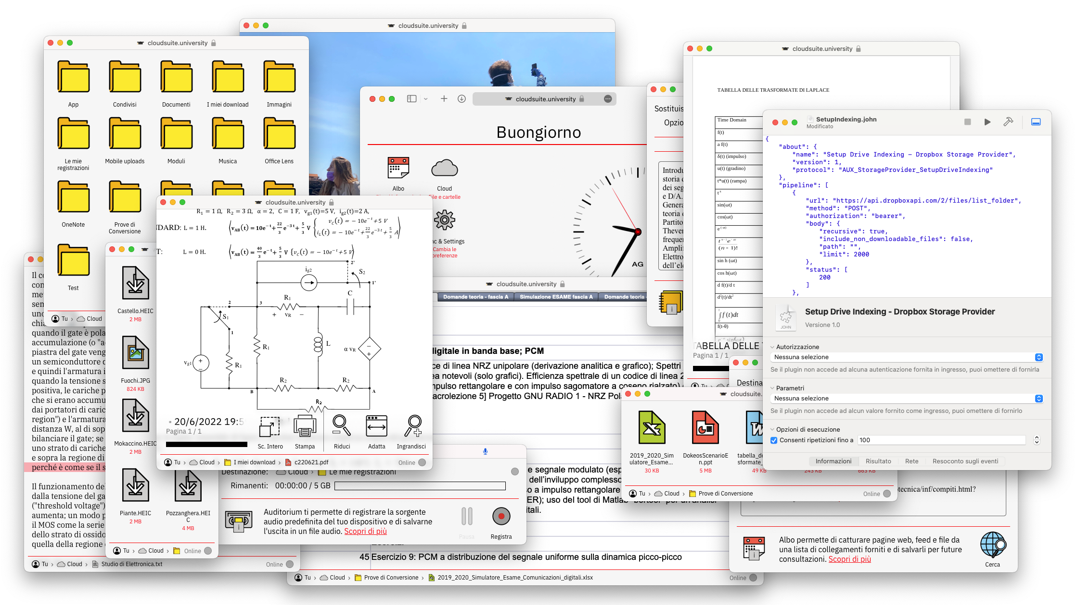

Obiettivi e Contenuti
The University Cloud Suite
Obiettivi e Contenuti
The University Cloud Suite
Obiettivi e Contenuti / The University Cloud Suite
37000 lines of source code and counting…
Albo • Syllabus • Auditorium • Sync and Settings • Plugins • Storage • CodeViewer • MediaPlayer • PDFViewer • TextViewer • WebViewer • The Object Tree Traversal (OTT)
The Auxiliary Toolkit
TKAboutDialog • TKBroadcastChannel • TKPlainButton • TKLinkButton • TKCheckmarkButton • TKCheckmarkGroup • TKCSSVariables • TKClock • TKColumnScroll • TKDesktopView • TKDialogForm • TKDialogApp • TKDriveManager • TKEventListener • TKPlainField • TKDottedField • TKFont • TKFooter • TKPageHeader • TKSectionHeader • TKIconImage • TKIconButton • TKIconView • TKIconDesktop • TKIconBanner • TKIconGroup • TKIconBar • TKInfoDate • TKInfoEntry • TKInfoPanel • TKLocalizedNode • TKLocalizedString • TKMarqueeText • TKPageManager • TKPaperTexture • TKPathComponent • TKPathBar • TKMenuItem • TKPopupMenu • TKProgressComponent • TKProgressBar • TKSeekBar • TKPulsingLoader • TKLineSeparator • TKThinSeparator • TKRegularSeparator • TKMediumSeparator • TKBoldSeparator • TKDottedSeparator • TKSpeaker • TKStatusBar • TKWebPage • TKWindowFullscreen • TKRootWindow • TKWindowLocation • TKPopupWindow • TKWindowButton • TKWindowState
The JSON HTTP Notation (JOHN)
JOHN+Options+Group • About • Assertion • Authorization • Body • Execution+Redirection • IOProtocol • IOPayload • IOMarkup+XML+HTML • Merger • Cookies • Parameters • Repetition • Result • Stage • Variable+Substitution • AnyResult • ExpectedResult • ExpectedValue • SettableValue • HTMLParser • Subscript+Element+Key+Index+Bound+Pattern • DebugDelegate • LoggerDelegate • JOHNEditor
Converters for LibreOffice-Accepted File Formats (CLAFF)
Office Open XML • OpenDocument • Pages • Numbers • Keynote • Rich Text Format • EPUB • DOC • XLS • PPT • CSV
Swift • Vapor • Fluent • Foundation • TypeScript • WebAuthn • Shadow DOM • Web Components API • IndexedDB • SharedWorker • OPFS • Web Audio API • Media Capture API • WebLocks • Screen Wake Lock API • BroadcastChannel • CSS Variables • PointerEvents • Drag and Drop API • History API

Slide 3
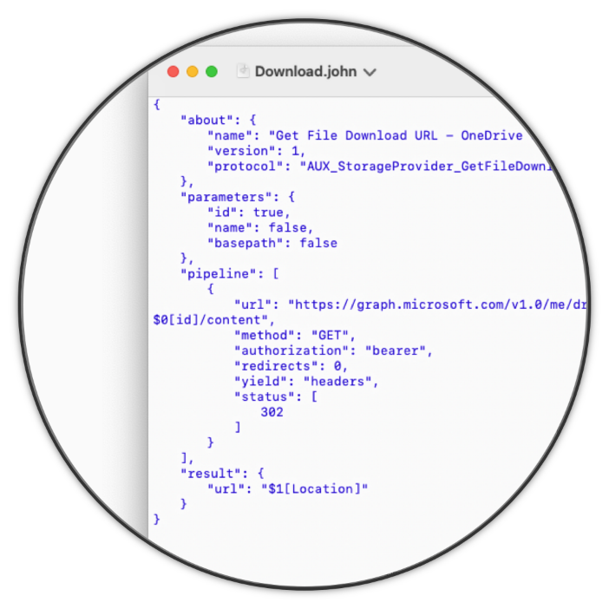
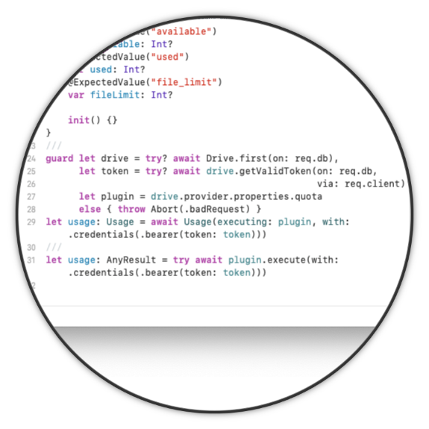
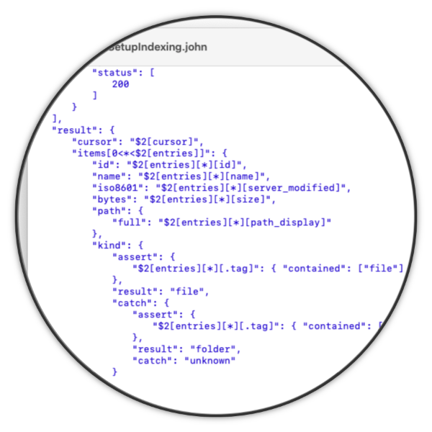



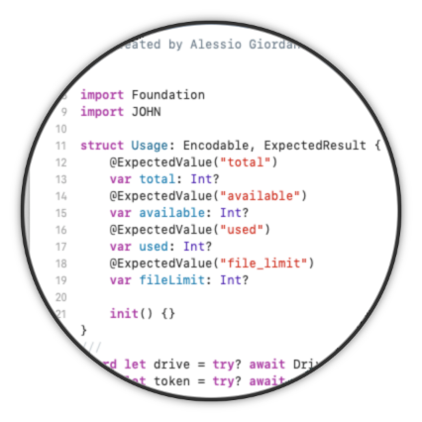
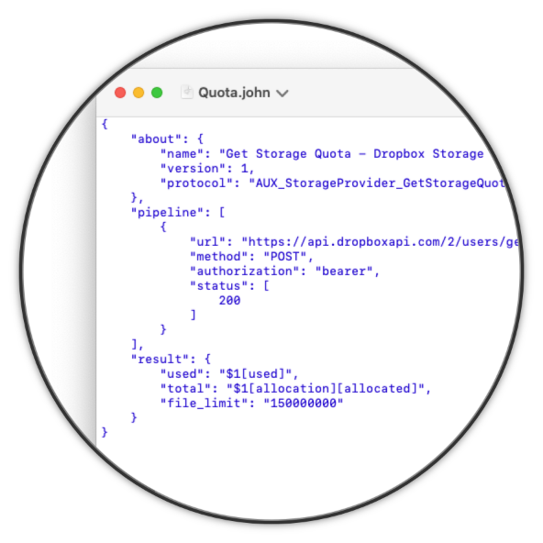
The JSON HTTP Notation
Risultati e Conclusioni
JOHN Language Specification
JOHN Runtime for Swift
JOHN Editor for macOS

